Slide 1
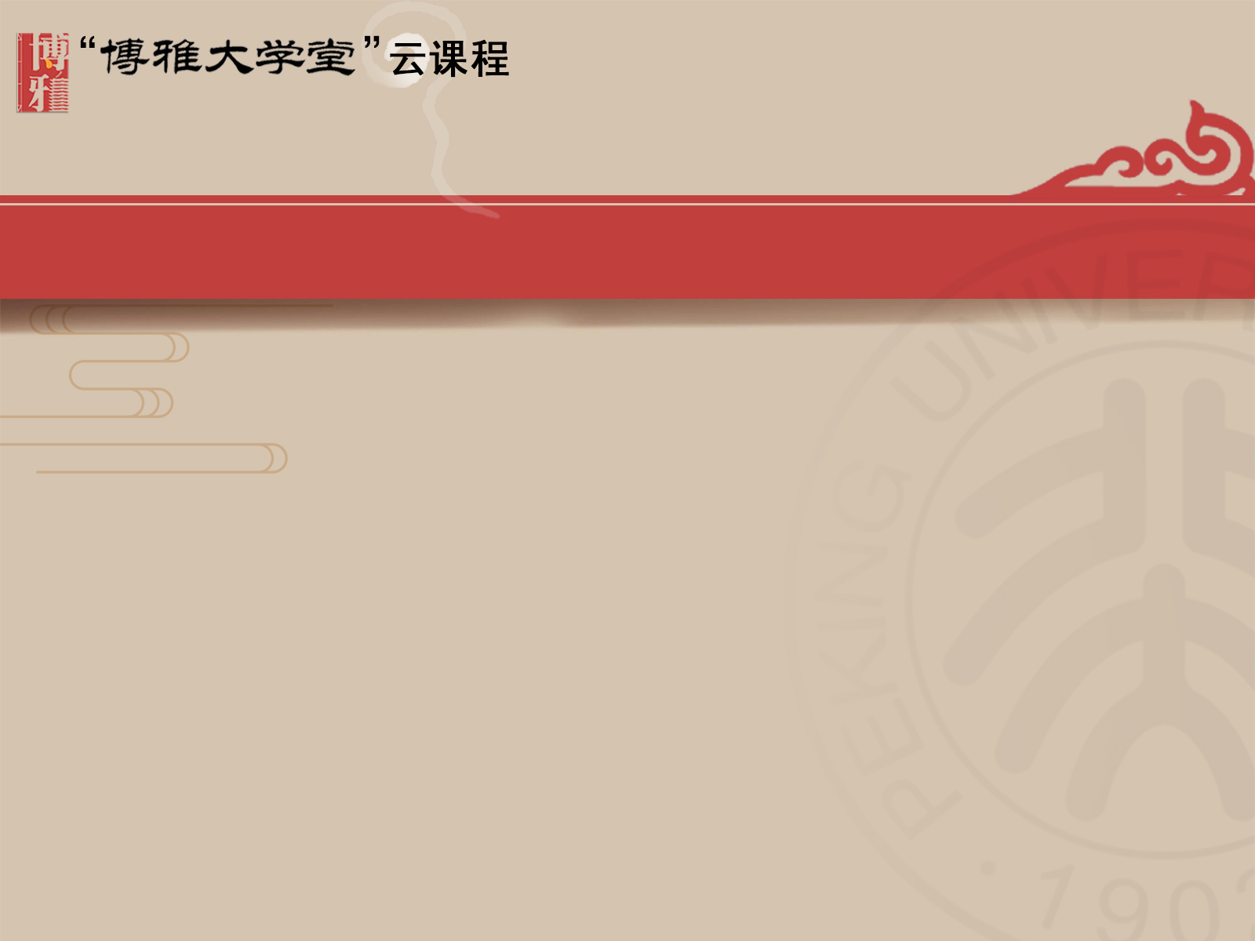
Chapter 3
The Deep Structure of Culture:
Lessons from the Family

Slide 2
Contents
The Deep Structure of Culture
Family

Slide 3
3.1 The Deep Structure of Culture P78-79
The key to how members of a culture view the world can be found in that culture's deep structure.
It is this deep culture, the conscious and unconscious assumptions about how the world works, that unifies a culture, makes each culture unique, and explains the “how” and “why” of a culture's collective action——action that is often difficult for “outsiders” to understand.
Examination of some aspects of a culture's deep structure can provide insight into and improve understanding of that culture's perspectives on ethics, notions of child rearing, ideas about God, nature, aesthetics, and the meaning of life, and even attitudes toward earth.

Slide 4
3.1 The Deep Structure of Culture P80-83
Deep Structure Institutions Transmit Culture's Most Important Messages
Deep Structure Institutions and Their Messages Endure
Deep Structure Institutions and Their Messages Are Deeply Felt
Deep Structure Institutions Supply Much of a Person's Identity

Slide 5
3.1.1 Deep Structure Institutions Transmit Culture's Most Important Messages P81
The social institutions of family, state, and religion carry the messages that matter most to people. Whether you seek material possessions to attain happiness or choose instead to seek spiritual fulfillment, the three deep structure institutions (family, state, and religion) help you make major decisions regarding how to live your life. These cultural institutions and the messages they generate tell you whether you should believe in fate or the power of free choice. They form your notions about right and wrong, why there is suffering, what to expect from life, where your loyalties should lie, and even how to prepare for death.

Slide 6
3.1.2 Deep Structure Institutions and Their Messages Endure P82
Deep structure institutions endure. They work in harmony to preserve the wisdom, traditions, and customs that make a culture unique. In China, students are being taught about the “one hundred years of humiliation” suffered under Western and Japanese imperialists in the nineteenth and twentieth centuries.

Slide 7
3.1.3 Deep Structure Institutions and Their Messages Are Deeply Felt
P82
The content generated by these institutions (and the institutions themselves) arouses profound and emotional feelings about loyalty and nationalism. Think for a moment about the fierce reactions that can be produced in the United States when someone takes God's name in vain, burns the American flag, or calls someone's mother an obscene word. Countries and religious causes have sent young men and women to war. And, frequently, politicians have attempted to win elections by urging voters to recognize the importance of God, country, and family.

Slide 8
3.1.4 Deep Structure Institutions Supply Much of a Person's Identity
P82
One of the most important responsibilities of any culture is to assist its members in forming their identities. Put in slightly different terms, you are not born with an identity, but through countless interactions, you discover who you are, how you fit in, and where you find security. As mentioned elsewhere, the family is most instrumental in the early stages of the socialization process that establishes a child's personal identity. However, once you encounter other people, you begin to develop a variety of identities. (“I”— “we”)

Slide 9
3.2 Family P84
The family not only supplies the child's basic physical needs, but also functions as the first “carrier” of the essential information that the child needs to know as a member of the culture. This means that the family must teach the historical background of the family and the culture, manners and correct behavior, cultural and individual identity, traditions, and language. In short, the family is asked to transform a biological organism into a human being who must spend the rest of his or her life around other human beings. It is the family that greets you once you leave the comfort of the womb. In this sense, the family is the first and chief socializing agent.

Slide 10
3.2 Family P82
As the earliest community to which a person is attached and the first authority under which a person learns to live, the family has a series of responsibilities that directly relate to perception and communication:
First, while a culture's core values and worldview derive from its predominant religious and cultural history, the family is the first and primary caretaker of these views and values.
Second, families are important because they supply all of us with a sense of our identity.
Third, families are important from a communication perspective, as they provide a setting for the development of an individual's self-concept.

Slide 11
3.2 Family
Definition of Family
Forms of Family
Globalization and Families
Functions of the Family
Cultural Variants in Family Interaction
The Elderly
Social Skills
Developing Communication Competence Through the Family

Slide 12
3.2.1 Definition of Family P85
A single definition of family is difficult to construct, since what constitutes a family, especially in the United States, can take a variety of configurations.
A definition advanced by Lamanna and Riedmann is acceptable:
A family is any sexually expressive or parent-child or other kin relationship in which people——usually related by ancestry, marriage, or adoption——
form an economic unit and care for any young;
consider their identity to be significantly attached to the group;
commit to maintaining that group over time.

Slide 13
3.2.2 Forms of Family P85
The form and type of the family manifest the cultural and historical beliefs of each culture. Most people encounter two families during the course of their lives:
the family they are born into (the family of orientation)
the family that is formed when and if they take a mate.
Once a person becomes part of either one of these families, he or she also finds him- or herself a member of a nuclear or extended family.
A nuclear family: a parent or parents and a child or children as one unit
An extended family: typically includes grandparents and relatives

Slide 14
3.2.2.1 Nuclear Families P86
Nuclear families, usually referred to as “two-generation families,” make up the pattern found in most of the United States and in many other Western cultures. The nuclear family is made up of two generations: the parents and their unmarried children. Each member of a nuclear family has a series of evolving relationships with every other member: husband and wife, parents and children, and children with each other.

Slide 15
3.2.2.1 Nuclear Families P86
The nuclear family, like all deep structure institutions, manifests many of the values of the culture that stresses this family pattern.
Cultural values of the nuclear family are also reflected in child-rearing practices.
American cultural values toward and treatment of the elderly are likewise replicated in nuclear families. In these families older members of the family do not normally spend their “senior” years living with their children.

Slide 16
3.2.2.2 Extended Families P86
There are twice as many extended families as there are nuclear families. Extended families include other relations and generations in addition to the nuclear family, so that along with married parents and their offspring, there might be the parents' parents, siblings of the spouses and children, and in-laws. All members of the extended family live in one house or in homes close to one another, forming one cooperative unit.
Historically, the cooperative units within the extended family have gathered for economic reasons and to share the workload and rearing of children. In an extended family, a set of behaviors and values may be acted out that differ from those found in nuclear families.

Slide 17
3.2.3 Globalization and Families P87
Globalization has redefined families throughout the world. The velocity of social change around the globe in the 21st century is shaping the family as an institution in revolutionary ways. In every society traditional notions about family life, work, identity and the relationships of individuals and groups to one another are being transformed due to globalizing forces.

Slide 18
3.2.3 Globalization and Families P87
The most obvious impact of globalization is that it has created a world where millions of workers now leave their families and move from one country to another to seek jobs and higher wages. Many of these people migrate as a way to escape poverty. However, when they “escape,” they often transform the makeup and character of their family, as migration places “significant stress on relationships among parents, children, elders, and other family members.”
The stress of breaking up the family can take a variety of forms. There is an impact on the social lives of both the migrants who move to a new culture and the families they leave behind. There are also countless occasions when parents who are illegal are sent home, and the children often remain in the new country without their parents.

Slide 19
3.2.4 Functions of the Family
Reproductive function
Economic function
Socialization function
Language acquisition function
Identity function

Slide 20
3.2.4.1 Reproductive Function P88
The most important function of the family in any culture is reproduction. The family makes continuation of the culture possible by producing (or adopting) children to replace the older members of the culture as they pass on. This essential function allows a culture to perpetuate itself. Without the infusion of new life, the culture would soon disappear.

Slide 21
3.2.4.2 Economic Function P89
The second function of families is to supply children with the necessities of life (food, clothing, shelter). In subtle and manifest ways, the family teaches economic sharing and responsibility. Although the methods for generating goods and services and even the means of distribution vary from culture to culture, the family consumes food and other necessities as a social unit.

Slide 22
3.2.4.3 Socialization Function P89
Teaching children how to fit into their particular culture is one of the family's most important tasks. Part of a family's socialization process is teaching the culture's core values, beliefs, ways of behaving, and worldview. This means that parents teach their children behaviors that are appropriate, expected, moral, or polite. Not only are norms and values passed along by families to children, but families also give them their initial exposure to questions of faith.
In short, the family provides the environment within which human values and morals develop and grow in the new generations; these values and morals cannot exist apart from the family unit.

Slide 23
3.2.4.4 Language Acquisition Function P89
The family is the place where children learn the language of the culture they are born into. The process of learning words, what they mean, and how to use them begins at birth and has its origins in the family. From how voices sound (learning dialects) to the objects those voices are referring to (the meaning of “mama” and “dada”) make family the main “teacher.”

Slide 24
3.2.4.5 Identity Function P90
The family is perhaps the most important of all identities, as it is a precursor to other identities. Family is not only the basic unit of a society but also provides individuals with their most essential social identity. The family accomplishes this by giving children knowledge about their historical backgrounds, information regarding the permanent nature of their culture, and specific behaviors, customs, traditions, and language associated with their ethnic or cultural group.

Slide 25
3.2.5 Cultural Variants in Family Interaction P90
Before beginning this section on the role of family in cultural interaction patterns, two disclaimers are in order.
All of the major institutions of a culture are linked. This means the family works in conjunction with other aspects of a culture.
Families within a culture may also display a range of differences.
In short, there are variations among and within cultures.

Slide 26
3.2.5 Cultural Variants in Family Interaction
Gender roles
Individualism and collectivism
Individualism and the family
Collectivism and the family

Slide 27
3.2.5.1 Gender Roles P91
One of the most important family patterns is the teaching of accepted gender roles. The learning of acceptable gender roles begins as soon as the newborn arrives. The initial announcement regarding the sex of the child immediately allows the family to begin the crucial role of socializing the newborn. The gender differences are reflected in the social roles men and women play, how much authority is given to each other, who are the major decision makers within the culture, and which gender is most valued. In short, the task of “teaching” children behaviors associated with each other falls on the family regardless of the culture.

Slide 28
3.2.5.2 Individualism and Collectivism
P98
The two orientations of individualism and collectivism play a significant role in child-rearing practices. Although the terms “individualism” and “collectivism” seem to be polar opposites, they are actually the end values of a continuum along which cultures can be situated.
The individual-collective dimension is a culture's tendency to encourage people to be unique and independent or conforming and interdependent.

Slide 29
3.2.5.2 Individualism and Collectivism
P98
Individualistic cultures: value the individual over the group. The individual is perceived as a sovereign stand-alone entity. Each person's uniqueness is of paramount value in individualistic cultures. This means that values such as independence, competition, self-determination, pursuing individual goals, independent living, and the “I” being the most important form of identity are the norms.
Collective cultures: emphasize the needs and goals of the group rather than the self. This means that values such as interdependence, group achievement, cooperation, and the like are stressed.

Slide 30

Ego / self-image
West China

Slide 31
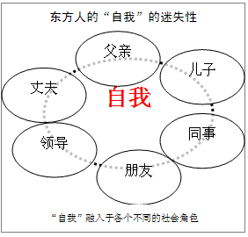

Slide 32
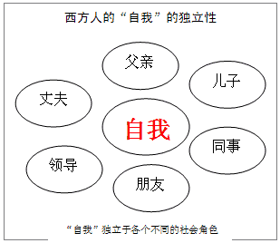

Slide 33
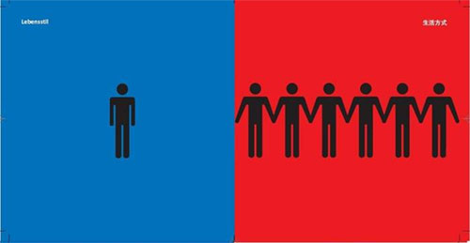
Difference in lifestyle
West China

Slide 34

In the party
West China

Slide 35
Friendship
Collectivists hold that one’s business is also the business of the group---friends should be connected with each other’s personal matters….(what is mine is yours.)
Individualists hold that people should mind their own business, privacy should be respected, people should be able to think freely.(what is mine is not to be used without my permission.)

Slide 36
3.2.5.3 Individualism and the Family P99
Most cultural characteristics have their roots in the deep structure of a culture. For Americans, individualism, as it applies to families, is partially linked to the history of the United States.
In the United States, most individuals were able—and continue even now—to make decisions that serve their own interests instead of those of the larger group. In most cases, this encourages a shrinking compliance with the authority of the family and stresses self-reliance. The independence expected and valued in individualistic cultures encourages autonomy.
Apart from the United States, Germany, Switzerland, Canada, Australia, France, Finland and many other cultures also “teach” and reward individualism within the family.

Slide 37
3.2.5.4 Collectivism and the Family P99
In collective cultures, people experience a profound allegiance and attachment to their families. The family loyalty in India can be observed in the fact that “feelings of self-esteem and prestige originate more from the reputation and honor of one's family than from any individual attainments.” The collective cultural orientation found in Latino families emphasizes family responsibilities and interdependence to maintain family groups. Latino family acts as a type of social organization that places the family ahead of the individual's interests and development. It is part of a traditional view of the society that highlights loyalty and cooperation within the family.

Slide 38
3.2.6 The Elderly P102-106
Learning about and coping with the life changes associated with aging is a cultural universal.
United States: most members of the dominant culture have a rather negative perception of the elderly.
Latino: the elderly are highly respected, play a dominant role in the family, and are always cared for.
Arab: the authority, wisdom, and counsel of elder family members are still to a great extent accepted.
Asian: the reason for the respect and reverent attitude toward the elderly is ancestor worship.
East African: the elderly preside over the priestly functions of ancestral shrine observances on the household level.
American Indian: there is a deep and clear deference and respect regarding the elderly.
African American: elders are recognized, empowered, and authenticated.

Slide 39
3.2.6 The Elderly P106
There are numerous reasons for the subtle and obvious changes to families throughout the world which influence how the elderly are perceived and treated.
First, the population is getting older. Across the globe, medical advances have produced a period in history where people are living longer.
Second, one of the end products of globalization is that more and more people are moving away from their established communities.
Third, there are a number of common pressures and processes confronting family structures and resources. Social change, demographic shifts, and changes in economics and the labor market are some of the key drivers of family change.

Slide 40
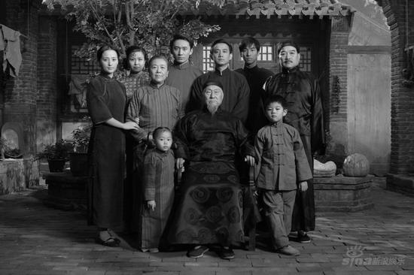
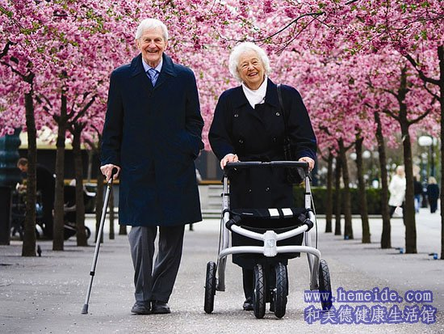
People in old age

Slide 41

Life in old age
West China

Slide 42
3.2.7 Social Skills P107
It is a major family responsibility to teach the numerous “cultural skills” a person will need to function effectively. Parents serve as models within the family environment, influencing the development of their children's social skills. That is, children learn how to interact with others by observing and imitating the ways in which their parents interact with others. The extent to which children and adolescents possess good social skills can influence their academic performance, behavior, social and family relationships, and involvement in extracurricular activities.

Slide 43
3.2.7 Social Skills P107-108
A sampling of some of the basic communication skills each child must learn are listed below:
When and how to disclose personal information to others.
How to show respect to other people.
How to start, maintain, and end a conversation.
Taking turns when interacting. When to listen and when to speak.
When not to interrupt.
The use of silence.
The correct volume for each setting.
Knowing appropriate and inappropriate topics of conversation.
How to use humor.
Correct use of nonverbal communication. Who can be touched? Where can they be touched?
...

Slide 44
3.2.7 Social Skills
Communication skills
Aggressive behavior

Slide 45
3.2.7.1 Communication Skills P108
Cultural differences in the teaching of communication skills can be observed when family patterns regarding how children are taught the value placed on interaction are considered. Children must learn about words and nonverbal actions so that they can become competent members of their culture. Through this language socialization, children learn the behaviors that are culturally appropriate in their community. Of course, what is “appropriate” is rooted in culture.

Slide 46
3.2.7.2 Aggressive Behaviors P108-109
Another example of cultural differences in child-rearing practices can be seen in a culture's acceptance or rejection of aggressive verbal and/or nonverbal behavior. Culture is an important factor that plays a role in aggression. Some cultures are low in aggression, whereas others are marked by a high level of aggression.
To be more specific, studies reveal the propensity toward aggressive behavior in most individualistic cultures, while in collective cultures (more common in Latin America and Asia,) the kind of assertive behavior would be regarded as rude and insensitive.

Slide 47
3.2.8 Developing Communication Competence Through the Family
P109
To communicate effectively with people of cultures different from one's own requires an appreciation of the role that family plays within those cultures. The reason for needing such a fund of knowledge about families is that a person's family influences how they communicate.
An understanding of the role of family in communication exchanges is important on two counts:
First, worldwide globalization and demographic changes in the United States have created a situation where settings involving communication have increased in both frequency and variety.
Second, many of the professions (teaching, healthcare, etc.) will involve working with families from diverse cultures.

Slide 48
3.2.8 Developing Communication Competence Through the Family
P110
Advice for effective communication with diverse families:
When working with intercultural families, one needs to develop an understanding of self and others.
Interpersonal communication proficiency includes listening intently, being empathetic, exercising decision-making and problem-solving skills, and displaying expertise in conflict resolution.
A successful communicator interacting with another culture reflects concern, respect, and sincerity.
Cultures and families differ in the degree to which they promote individuality and uniqueness versus conformity and interdependence.
Learn the roles that each family has assigned to gender and the elderly.
Learn all you can about age-appropriate behavior for each culture you will be dealing with.
Be aware of the problems created by the possible changes in family dynamics caused by acculturation into a new culture.

Slide 49
Thanks for watching

